Slide 1

COMP90018
Mobile Computing Systems Programming
WEEK 6 – Firebase, Connectivity
Weiwei Jiang
weiwei.jiang@student.unimelb.edu.au

Slide 2
1
Firebase
2
Connectivity
CONTENTS

Slide 3

Firebase

Slide 4
Firebase
Firebase is a mobile and web application development platform developed by Firebase, Inc. in 2011, then acquired by Google in 2014.
As of October 2018, the Firebase platform has 18 products, which are used by 1.5 million apps.
https://firebase.google.com/

Slide 5
Firebase
Functionality

Slide 6
Firebase – Develop
Fast mobile app development

Slide 7
Firebase – Authentication
Authentication:
Identify users without writing server code

Slide 8
Firebase – Database
Backend Database:
synchronize data with mobile apps

Slide 9
Firebase – Storage
Backend Storage:
manage media files uploaded by mobile apps

Slide 10
Firebase – Hosting
Cloud Platform Hosting

Slide 11
Firebase – Functions
Cloud Platform Functions

Slide 12
Firebase – Machine Learning & AI
Machine Learning & AI

Slide 13
Firebase – Test/Monitor Performance
Test/monitor mobile app

Slide 14
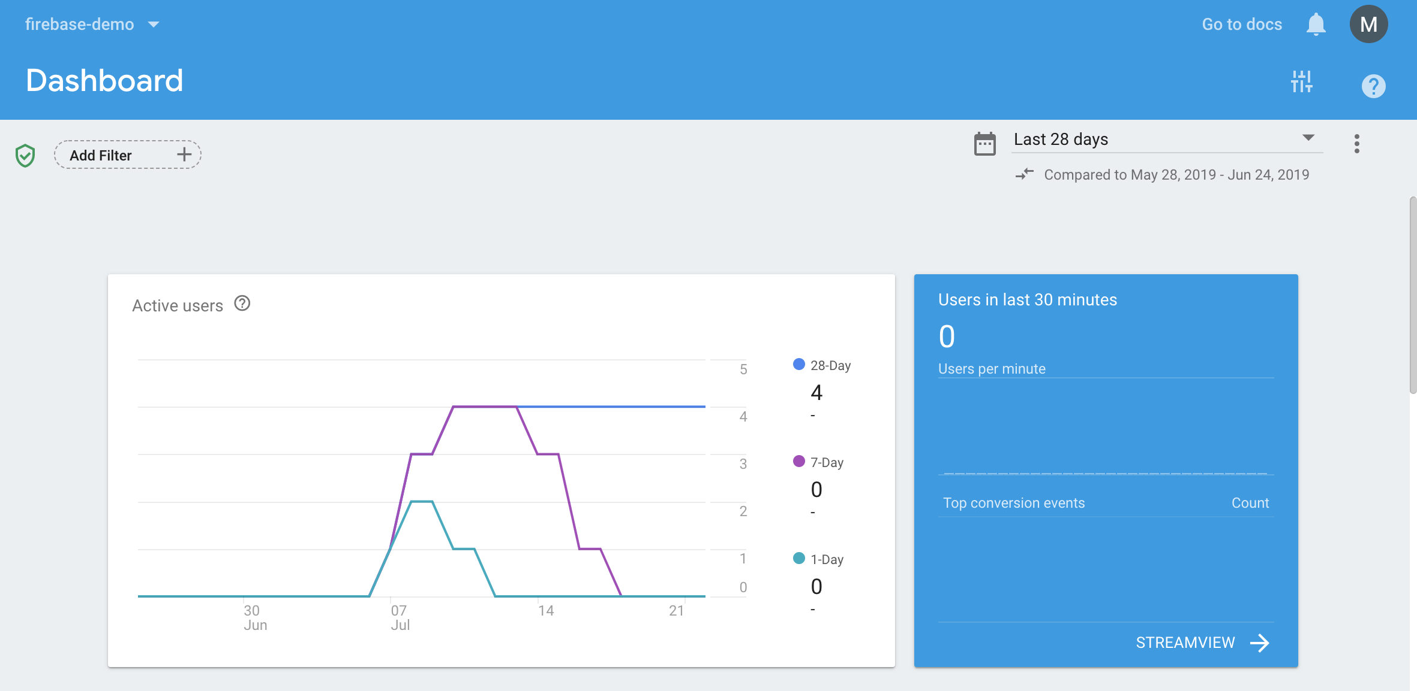
Firebase – Monitor Performance
Monitor mobile app

Slide 15
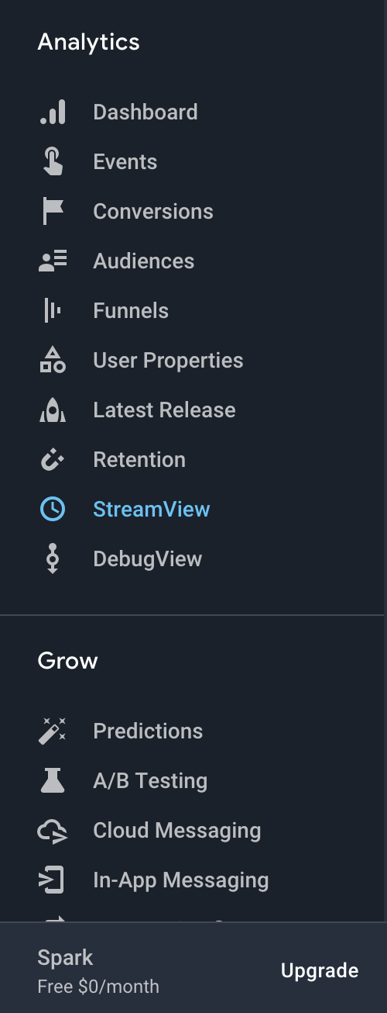
Firebase – More Functions
More Functions …

Slide 16
Firebase
First Firebase Application

Slide 17
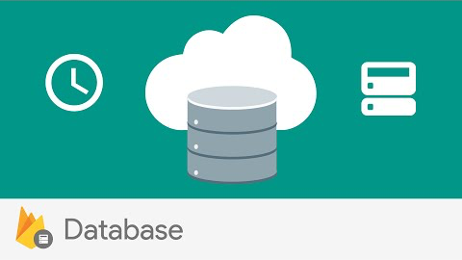
Firebase – Realtime Database
Store and sync data with Firebase NoSQL cloud database.
Data is synced across all clients in realtime, and remains available when your app goes offline.
https://firebase.google.com/docs/database

Slide 18
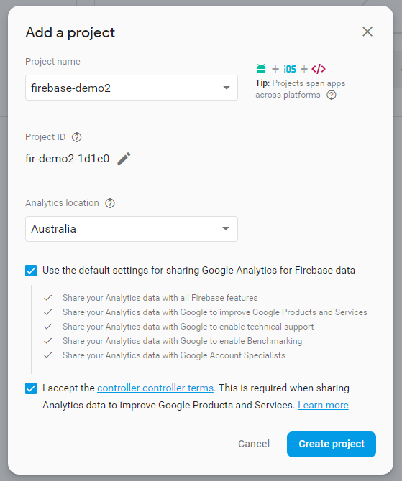
Create a Firebase Application
Step 1: Create a project at Firebase Console
https://console.firebase.google.com

Slide 19
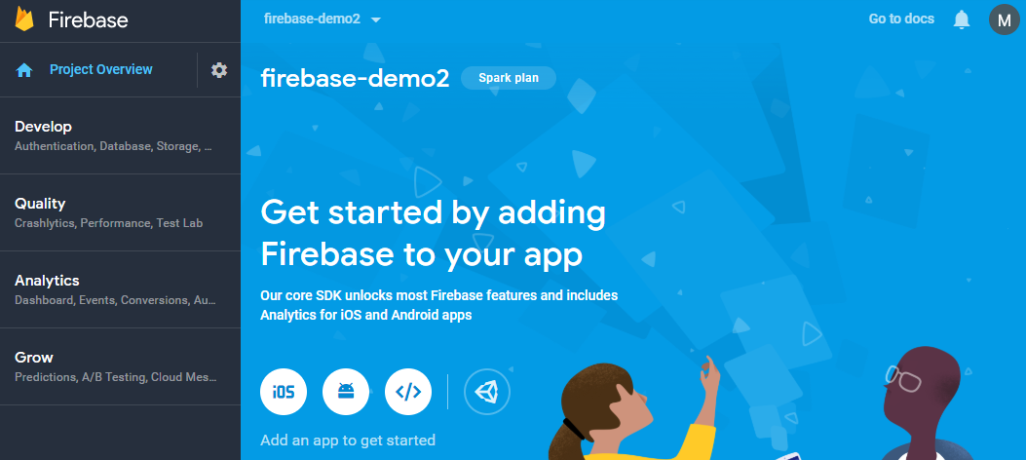
Create a Firebase Application
Step 2: Add an app to your project

Slide 20
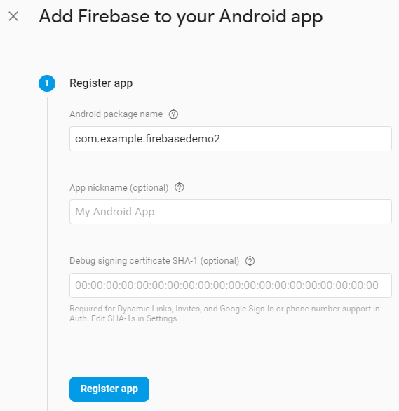
Create a Firebase Application
Step 3: Create an Android app and input the package name

Slide 21
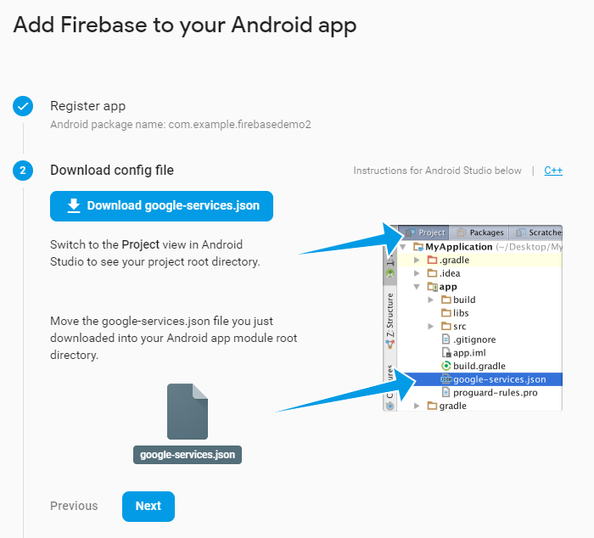
Create a Firebase Application
Step 4: Download the config file and put the file into the Android project

Slide 22
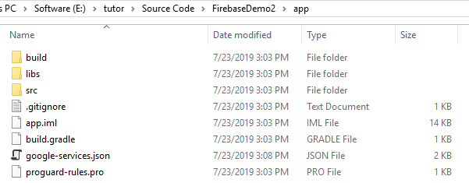
Create a Firebase Application
Step 4: Download the config file and put the file into the Android project

Slide 23
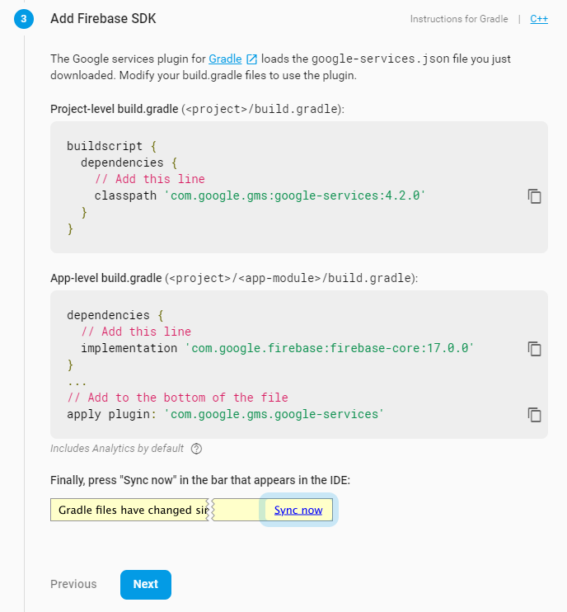
Create a Firebase Application
Step 4: Modify the build.gradle in both project level and app level

Slide 24
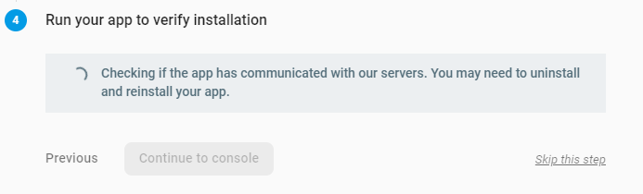
Create a Firebase Application
Step 5: Run your app to verify installation

Slide 25
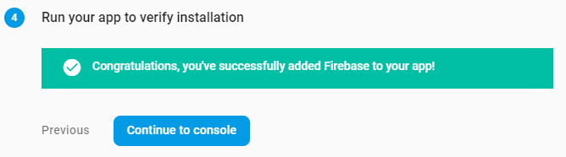
Create a Firebase Application
Step 5: Run your app to verify installation

Slide 26
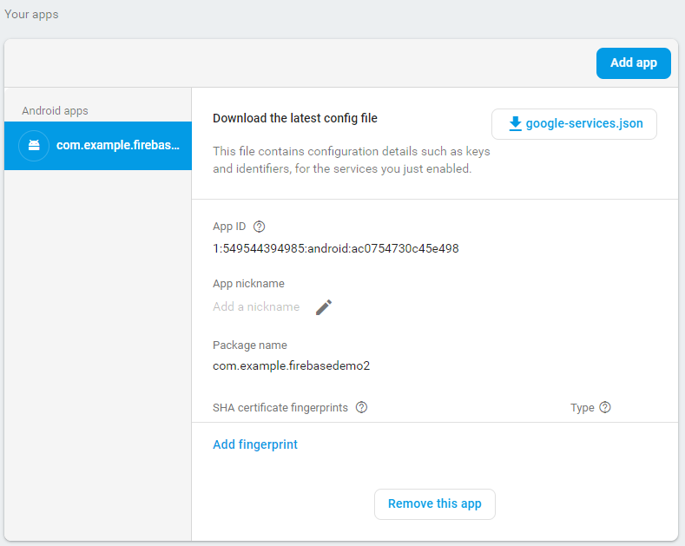
Create a Firebase Application
Finalize the installation

Slide 27
Firebase
Integrate Realtime Database into your application

Slide 28
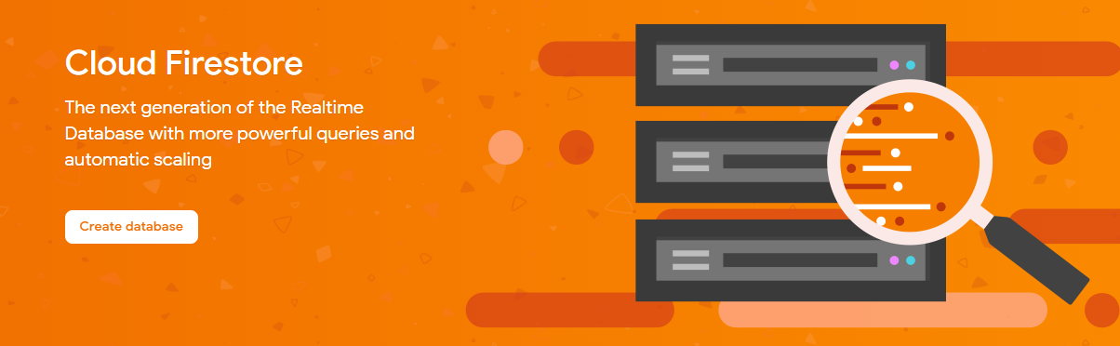
Integrate Realtime Database
Step 1: Create a real time database from Firebase

Slide 29
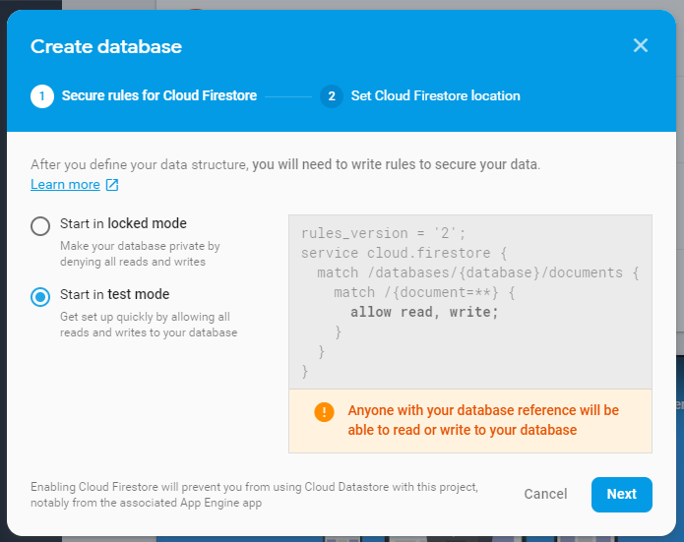
Integrate Realtime Database
Step 2: Select the test mode

Slide 30
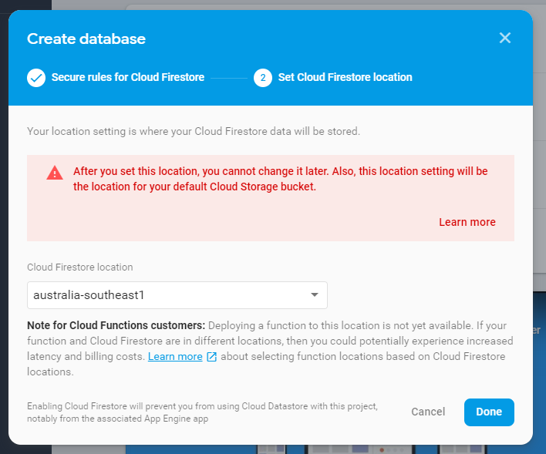
Integrate Realtime Database
Step 2: Select the location to Australia
or anywhere you want to deploy your database

Slide 31
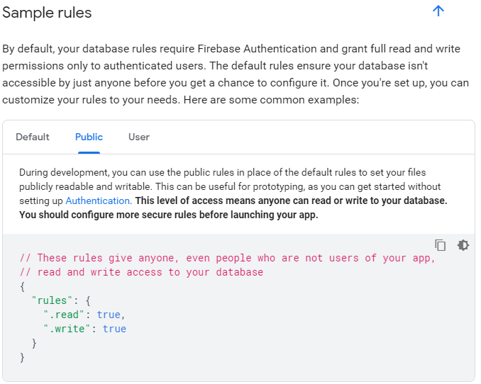
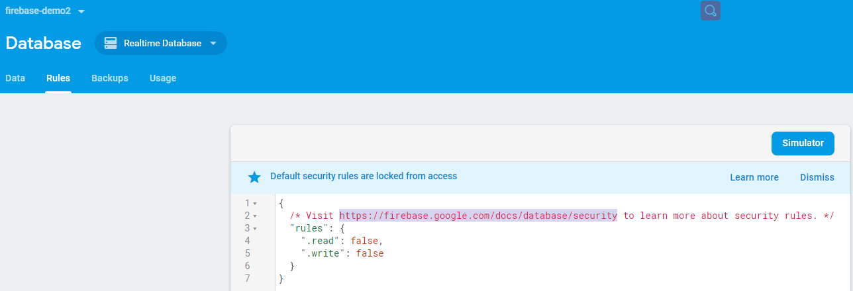
Integrate Realtime Database
Step 3: Change the Rules of Realtime Database to public (for debugging your application)

Slide 32
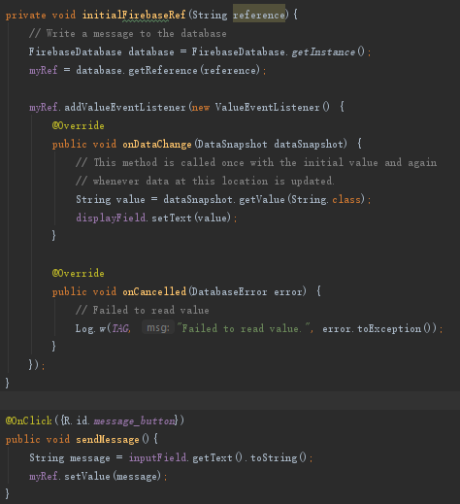
Integrate Realtime Database
Step 4: Modify the Android Application to monitor the data from Realtime database.

Slide 33
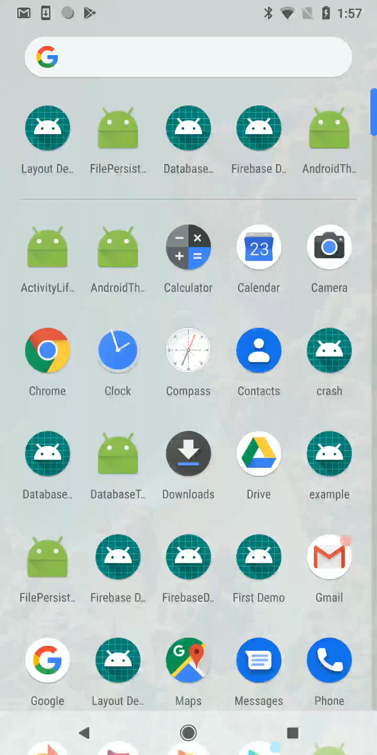
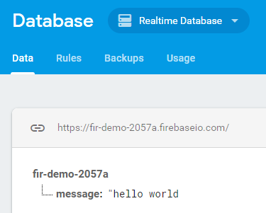
Integrate Realtime Database

Slide 34
Connectivity

Slide 35
Connectivity
Android provides APIs to let your app connect standard network, and interact other devices with protocols such as Bluetooth, NFC, etc.
https://developer.android.com/guide/topics/connectivity

Slide 36
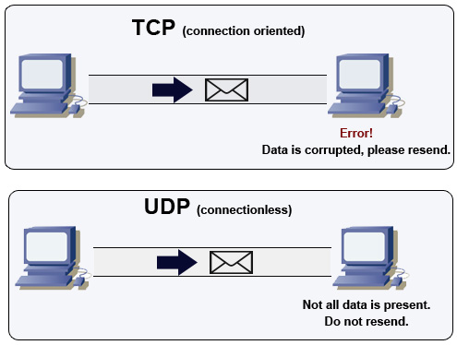
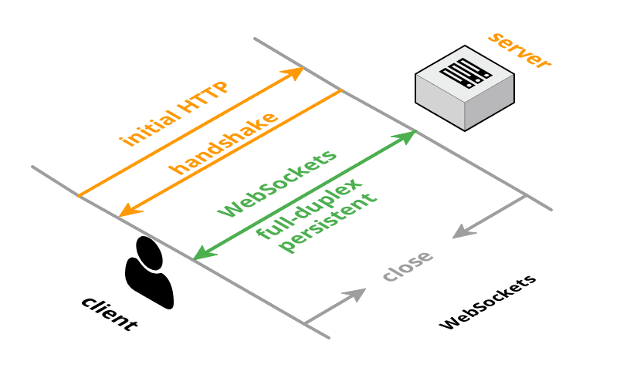
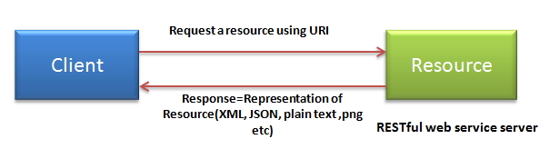
Connectivity
In this tutorial, we will focus on:
Bluetooth
Socket, HTTP, WebSocket

Slide 37
Connectivity
Bluetooth

Slide 38
Bluetooth
Bluetooth is a wireless technology standard for exchanging data between fixed and mobile devices over short distances using short-wavelength UHF radio waves.
https://en.wikipedia.org/wiki/Bluetooth

Slide 39
Bluetooth 4.0
Bluetooth Low Energy (Bluetooth LE, colloquially BLE, formerly marketed as Bluetooth Smart) is intended to provide considerably reduced power consumption and cost while maintaining a similar communication range.
https://en.wikipedia.org/wiki/Bluetooth_Low_Energy

Slide 40
Bluetooth in Android
The Android platform includes support for the Bluetooth network stack, which allows a device to wirelessly exchange data with other Bluetooth devices.
https://developer.android.com/guide/topics/connectivity/bluetooth

Slide 41

Bluetooth – Build Connection
Server
Request
Client
One device must be server, while another will be the client.

Slide 42
Bluetooth – Build Connection
Let me be server
Users can decide which is server

Slide 43
Bluetooth – Build Connection
Server
Server
Both be server first

Slide 44
Bluetooth – Build Connection
Server
Request
Server / Client
Either requests as client

Slide 45
Bluetooth – Build Connection
Server
Request
Client
Then, you have a connection

Slide 46
Android Bluetooth APIs
The application framework provides access to the Bluetooth functionality through the Android Bluetooth APIs.

Slide 47
Android Bluetooth APIs
Using the Bluetooth APIs, an Android application can perform:
Scan for other Bluetooth devices
Query the local Bluetooth adapter for paired Bluetooth devices
Establish RFCOMM channels
Connect to other devices through service discovery
Transfer data to and from other devices
Manage multiple connections

Slide 48
Build Connection Demonstration
Step 1: Get Permissions
<uses-permission android:name="android.permission.BLUETOOTH" />
<uses-permission android:name="android.permission.BLUETOOTH_ADMIN" />
<uses-permission android:name="android.permission.ACCESS_COARSE_LOCATION" />

Slide 49
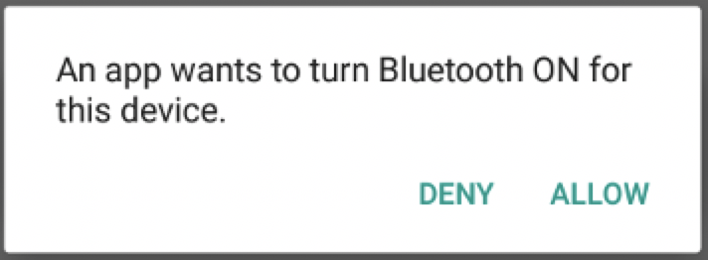
Build Connection Demonstration
Step 2: Get BluetoothAdapter
Checks the hardware availability
Helps users switch it on if it is off

Slide 50
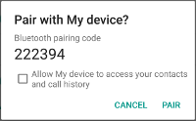
Build Connection Demonstration
Step 3: Pair other Devices
Find the other nearby device (must be discoverable)
Build connection using MAC address
Send/Receive data

Slide 51
Connectivity
Socket

Slide 52
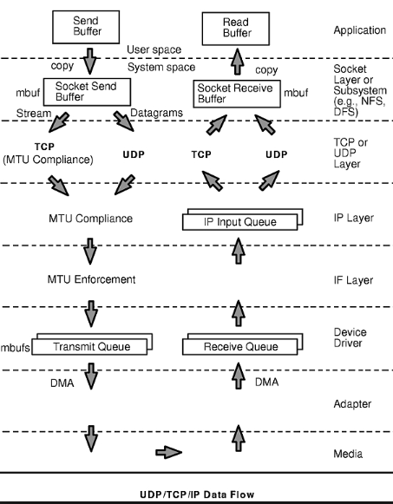
Socket – TCP/UDP
A network socket is an internal endpoint for sending or receiving data within a node on a computer network.
https://en.wikipedia.org/wiki/Network_socket

Slide 53
Socket – Stream Socket
Stream sockets, also known as connection-oriented sockets, which use Transmission Control Protocol (TCP), Stream Control Transmission Protocol (SCTP) ....
https://developer.android.com/reference/java/net/Socket
https://en.wikipedia.org/wiki/Transmission_Control_Protocol

Slide 54
Socket – Datagram Socket
Datagram sockets, also known as connectionless sockets, which use User Datagram Protocol (UDP).
https://developer.android.com/reference/java/net/DatagramSocket
https://en.wikipedia.org/wiki/User_Datagram_Protocol

Slide 55
Connectivity
HTTP/HTTPS

Slide 56
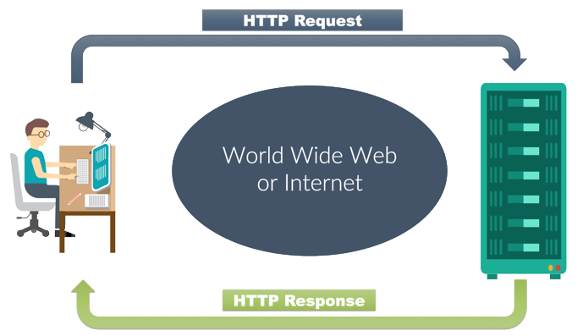
Hypertext Transfer Protocol (HTTP)
The Hypertext Transfer Protocol (HTTP) is an application protocol for distributed, collaborative, hypermedia information systems.
https://en.wikipedia.org/wiki/Hypertext_Transfer_Protocol

Slide 57
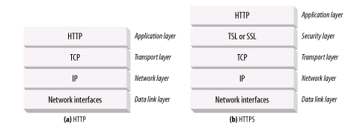
Hypertext Transfer Protocol Secure (HTTPS)
Hypertext Transfer Protocol Secure (HTTPS) is an extension of the Hypertext Transfer Protocol (HTTP). It is used for secure communication over a computer network and is widely used on the Internet.
https://en.wikipedia.org/wiki/HTTPS

Slide 58
Representational state transfer (REST)
Representational State Transfer (REST) is a software architectural style that defines a set of constraints to be used for creating Web services.
https://en.wikipedia.org/wiki/Representational_state_transfer

Slide 59
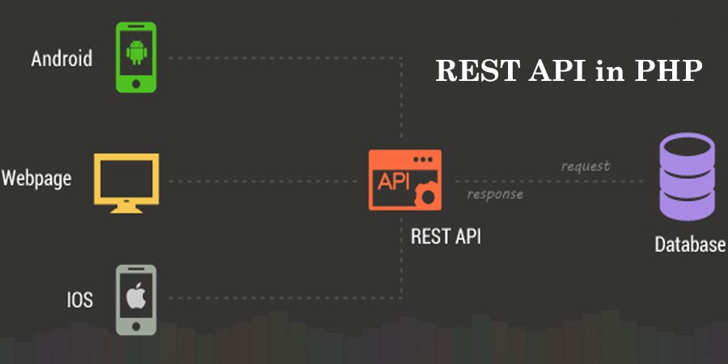
Representational state transfer (REST)
When HTTP is used, as is most common, the operations (HTTP methods) available are GET, HEAD, POST, PUT, PATCH, DELETE, CONNECT, OPTIONS and TRACE.

Slide 60
Connectivity
WebSocket

Slide 61
WebSocket
WebSocket is a computer communications protocol, providing full-duplex communication channels over a single TCP connection.
https://en.wikipedia.org/wiki/WebSocket

Slide 62
WebSocket
The WebSocket protocol enables interaction between a web browser (or other client application) and a web server with lower overhead than half-duplex alternatives such as HTTP polling, facilitating real-time data transfer from and to the server.

Slide 63
Connectivity
Frameworks

Slide 64

OKHttp
OkHttp is an HTTP client that’s efficient by default:
HTTP/2 support allows all requests to the same host to share a socket.
Connection pooling reduces request latency (if HTTP/2 isn’t available).
Transparent GZIP shrinks download sizes.
Response caching avoids the network completely for repeat requests.
https://square.github.io/okhttp/

Slide 65
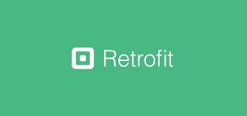
Retrofit
A type-safe HTTP client for Android and Java based on OKHttp, which is able to manipulate URL, Request, loading, caching, etc.
https://square.github.io/retrofit/
https://github.com/square/retrofit

Slide 66
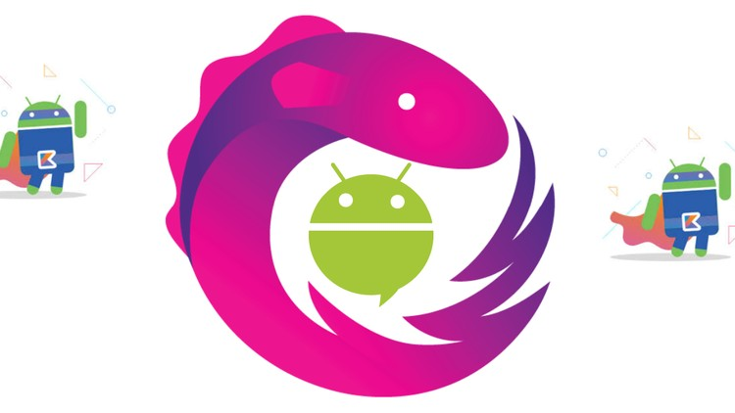
RxJava – An alternative way of threading
RxJava is a Java VM implementation of Reactive Extensions: a library for composing asynchronous and event-based programs by using observable sequences.
https://github.com/ReactiveX/RxJava

Slide 67
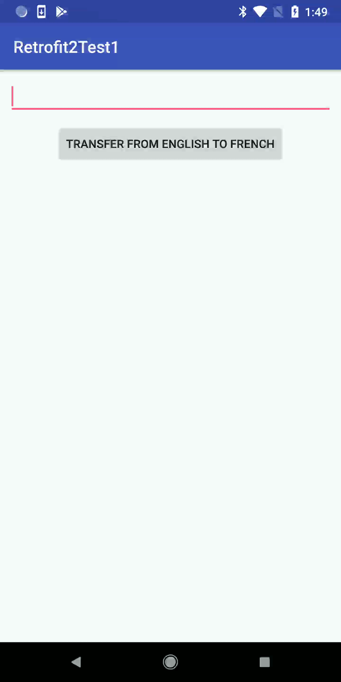
Retrofit – Demonstration

Slide 68
Assignment 2 feedback workshops
Thank you all for coming to our Android Development tutorials & Congratulations!
From next week we will start Assignment 2 feedback workshop.
To get timely feedback for your Assignment 2.
Prepare an agenda / your questions before coming.

Slide 69
Please re-join the zoom-meeting if
you come for the tutorial starting at 2pm.

